Slide 1
Sarcasm Detection {
[Using Transformers in YouTube Comments]
< Tom,Julia,Sterre,Raluca >
}
< How well can Transformer models detect sarcasm in youtube comments with and without added context?>

Slide 2
Research Question and Goals; {
Sarcasm and Context Dependency
< ‘the use of irony to mock or convey contempt’
- hard to detect by humans as well >
YouTube Comments
< Little literature on Youtube comments >
Connection to Text Mining
< web scraping, Transformer models,Sarcasm in NLP >
}

Slide 3
Process {
Step 01
Finding controversial YouTube videos
Step 02
Create the dataset + Choose the models
Step 03
Train the Models! With and without Context
Step 04
Analysis, Evaluation and Conclusion
}

Slide 4
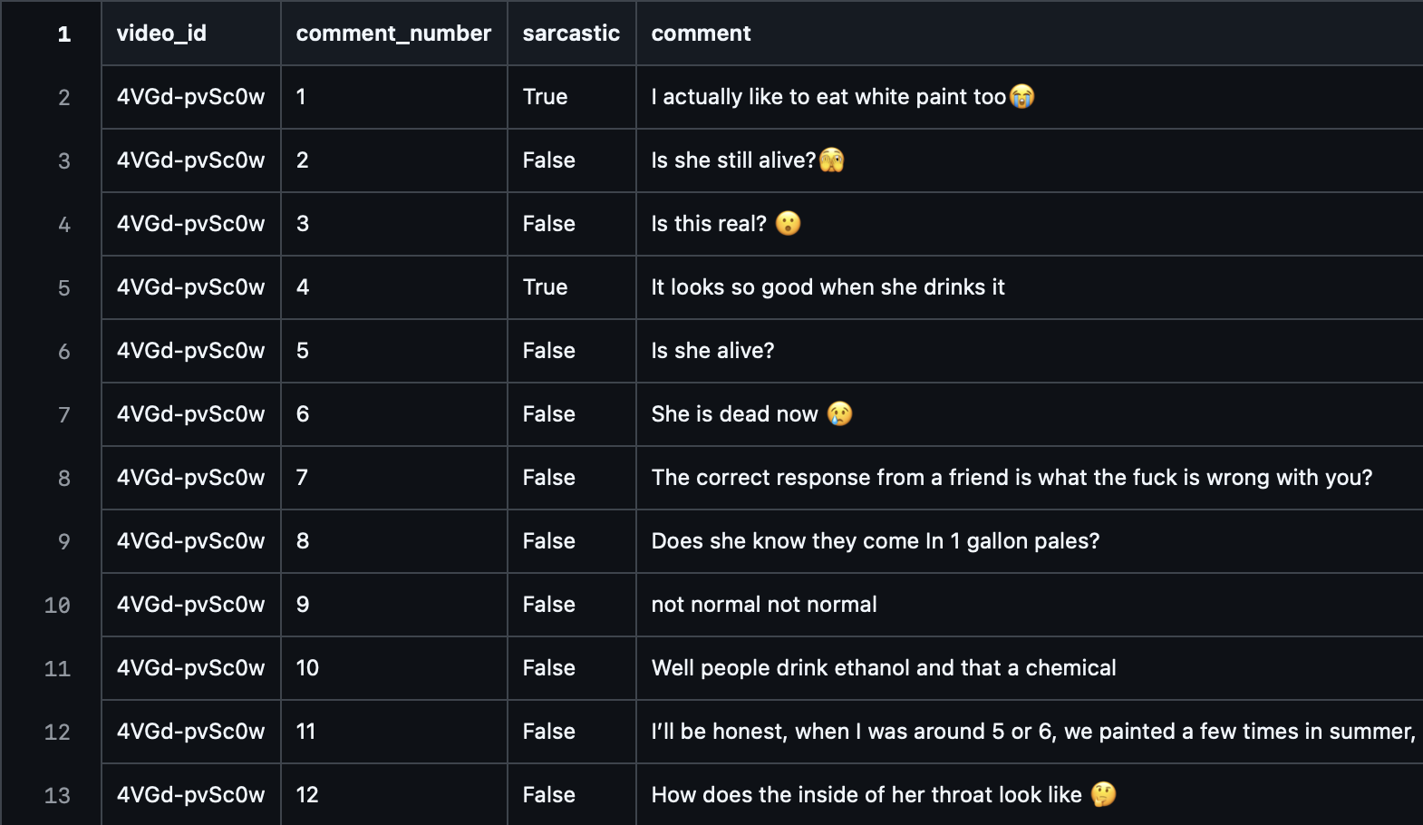
Dataset Creation {
//scraped 300 comments out of each video and created a csv file
//preprocessing
//manually classified all the comments
}

Slide 5
RoBERTa < /1 > {
[Models]
< Transformer-based model trained on general text >
}
BERTweet < /2 > {
< Pre-trained on 850 million English tweets>
}

Slide 6
Context Integration {
[Video Context] [SEP] [User Comment]
Example:
[Woman is addicted to eating soap] [SEP] [Why doesn’t she just eat cilantro]
}

Slide 7
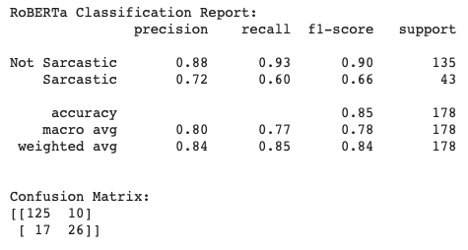
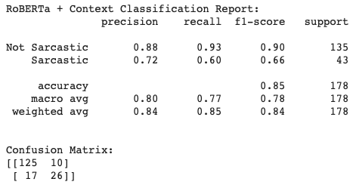
Results 15% test set
{RoBERTa (with / without context)}

Slide 8
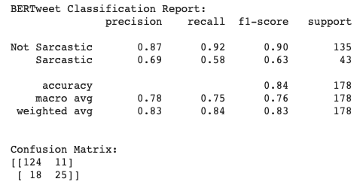
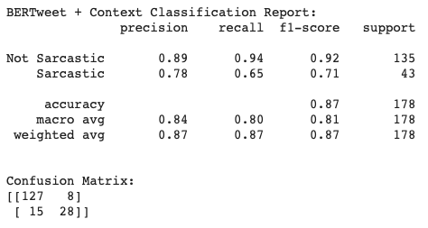
Results 15% test set
{BERTweet (with / without context)}

Slide 9
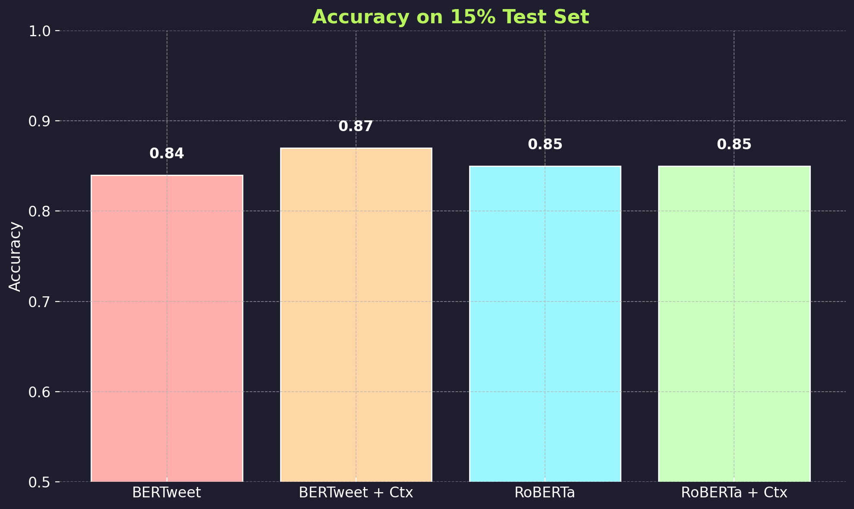
Table Of ‘Contents’ {

Slide 10
Main Issues {
Unbalanced dataset
Max input length
Num of parameters
}

Slide 11
Key Findings & ‘Improvements’{
Best Model
Context
< BERTweet + context
>
< Context helps models trained on informal text >
Dataset
Error Analysis
< Bigger Data Set + Fix Subjectivity >
< False negatives and False positives>
}

Slide 12
Resources {
// Datasaur. (2023). Using NLP to Keep YouTube Comments Safe. Retrieved from https://datasaur.ai/blog-posts/nlp-keep-youtube-comments-safe
// Jain, D., Kumar, A., & Garg, G. (2020). Sarcasm detection in mash-up language using soft-attention based bi-directional LSTM and feature-rich CNN. Applied Soft Computing, 91, 106198. https://doi.org/10.1016/j.asoc.2020.106198:contentReference[oaicite:0]{index=0}
//González-Ibáñez, R., Muresan, S., & Wacholder, N. (2011). Identifying sarcasm in Twitter: A closer look. In Proceedings of the 49th Annual Meeting of the Association for Computational Linguistics: Shortpapers (pp. 581–586). Association for Computational Linguistics. https://www.researchgate.net/publication/220874376:contentReference[oaicite:1]{index=1}
//Kataria, A., & Rathod, S. (2023). Sarcasm detection using natural language processing. SSRN Electronic Journal. https://ssrn.com/abstract=4451909:contentReference[oaicite:2]{index=2}
//Anup, A., G., S., H. R., S., Upadhyaya, M., Ray, A. P., & Manjunath, T. C. (2020). Sarcasm detection in natural language processing. Materials Today: Proceedings, 37, 3324–3331. https://doi.org/10.1016/j.matpr.2020.09.124:contentReference[oaicite:3]{index=3}
//TLC. (2013, March 25). This Woman Can't Stop Drinking Paint [Video]. YouTube. https://www.youtube.com/watch?v=K3TqdG4_7oc
//TLC. (2013, April 3). Woman Eats More Than 100 Bars Of Soap Every Year [Video]. YouTube. https://www.youtube.com/watch?v=TWkH1xZp3Gs
//TLC. (2014, August 27). I'm Addicted To Eating BEDS [Video]. YouTube. https://www.youtube.com/watch?v=OqsBuxCk4L8
//TLC. (2014, August 20). Addicted to Bathing In Bleach [Video]. YouTube. https://www.youtube.com/watch?v=E_5kX-5I3M8
}

